Slide 1


FINAL PROJECT
SHARESPACE
Advance Computer Programming

Slide 2



OUTLINE
Purpose
Demonstration
Limitation

Slide 3


WHY
PURPOSE?
To manage items donated by user
catagorize them
organize them
sort them
HOW
THEME? SDG?
Ensure sustainable consumption through the donation of items.
Creates an environment that reduce commercial waste(e-waste, books, furnitures..etc)

Slide 4


REQUIREMENTS

Slide 5
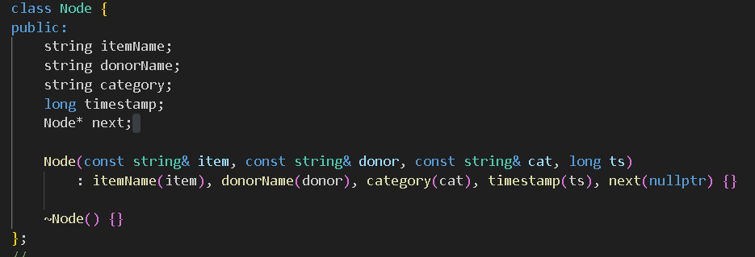
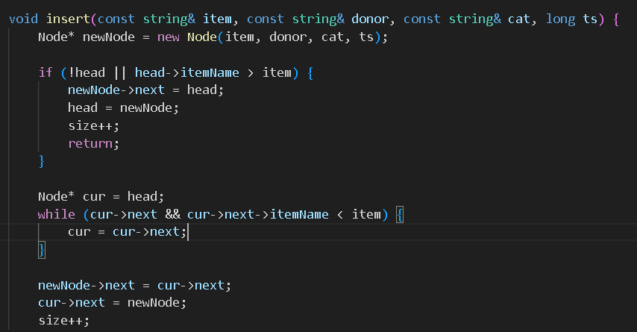
CLASS
3 DATA MEMBERS
LINKED LIST
SORTED LINKED LIST

Slide 6
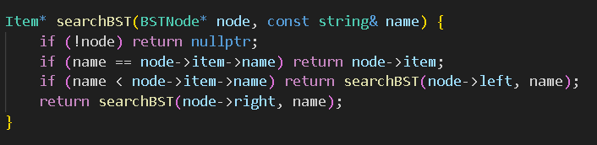
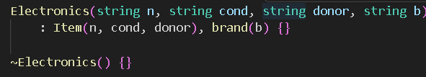
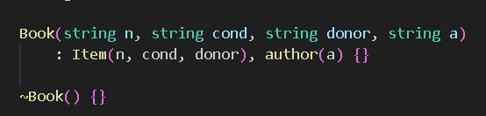
BST
BINARY SEARCH TREE
CLASS
CONSTRUCTOR DESTRUCTORS

Slide 7
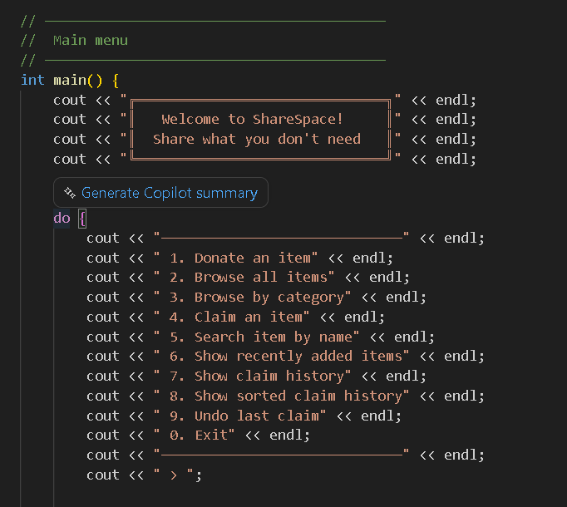
DISPLAY
DEMONSTRATION

Slide 8

LIMITATIONS

Slide 9


ISSUE 1
NO REPEAT ITEMS
An item cannot have the same name as an already existing item in the list
ISSUE 2
NO DATA STORAGE
There is no record of every item entered thus if the program is closed all the infomation is lost

Slide 10


ISSUE 3
NO SELF CATEGORIZING
When selecting others when donating an item the user cannot create a custom item category nor descrption
ISSUE 4
NO ITEM EDITTING
Once an item infomation is entered when donating the infomation about the item cannot be changed

Slide 11

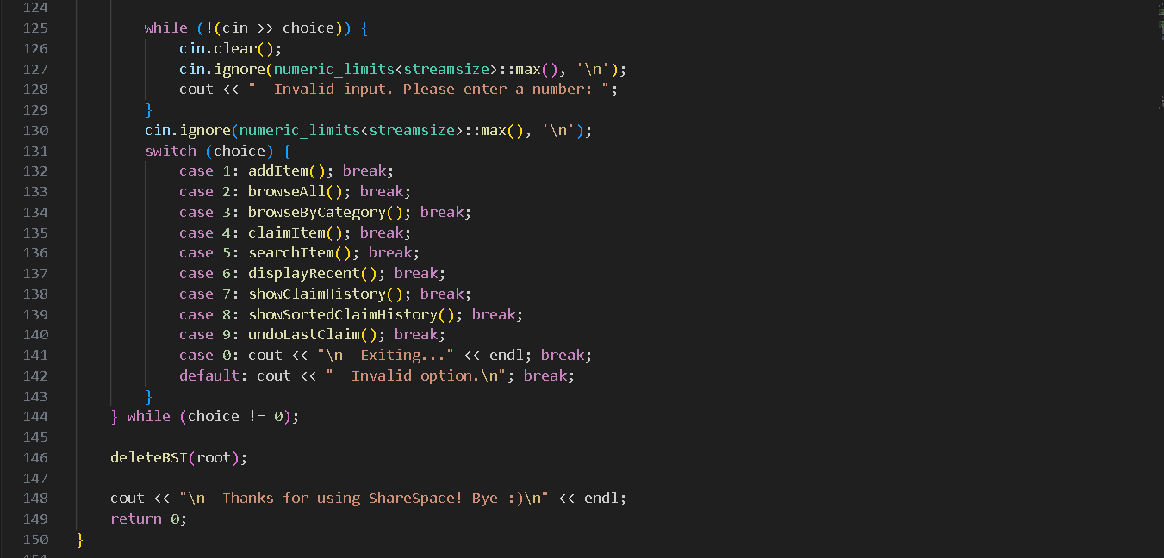
THANK YOU

